Slide 1
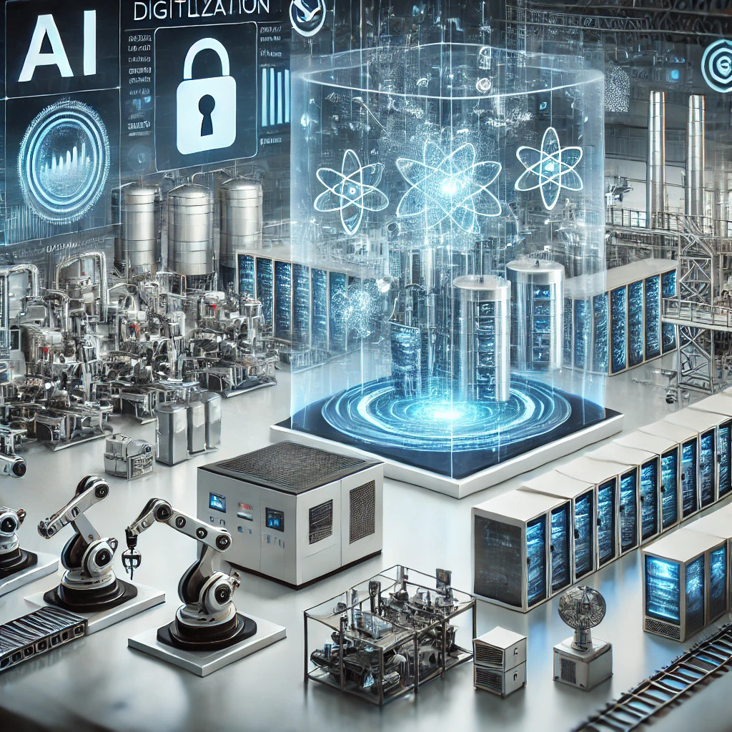
Digital Technologies
Distributed Systems,Basic Infrastructure, and Cloud Computing
Prof. Dr.-Ing. Sebastian Schlesinger
Professor of Business Computer Science
Cybersecurity and Embedded Systems Engineering

Slide 2
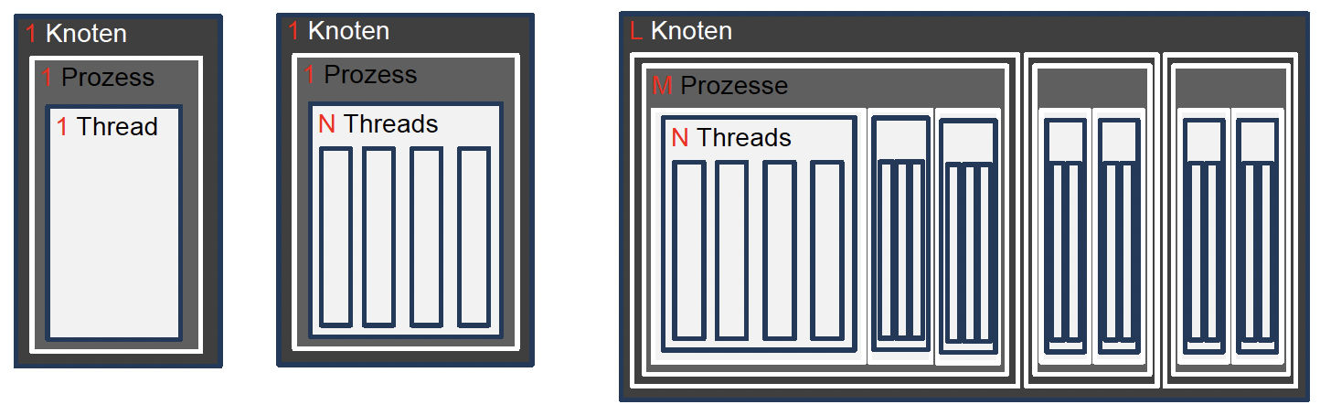
From Sequential Processing to Distributed Systems
Sequential processing
Multithreading, Multicore
Distributed System
Increased parallelism, big data use case

Slide 3
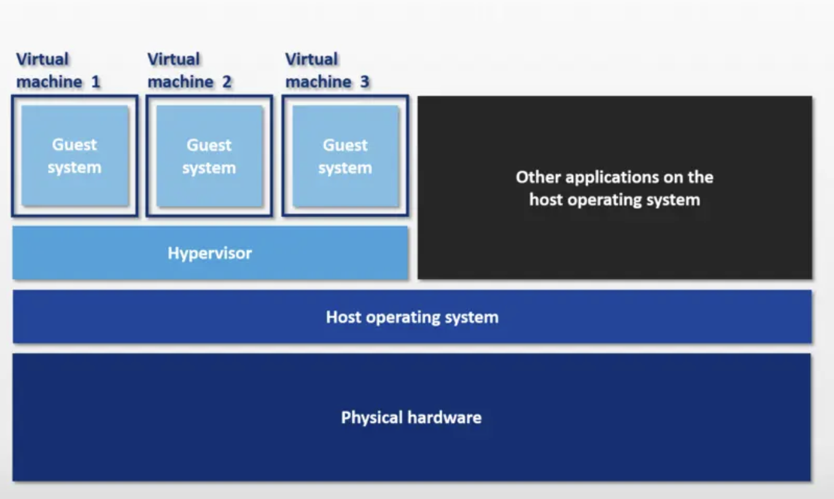
Enabling Technology: Virtualisation
Source: https://www.ionos.ca/digitalguide/server/know-how/virtual-machines/

Slide 4
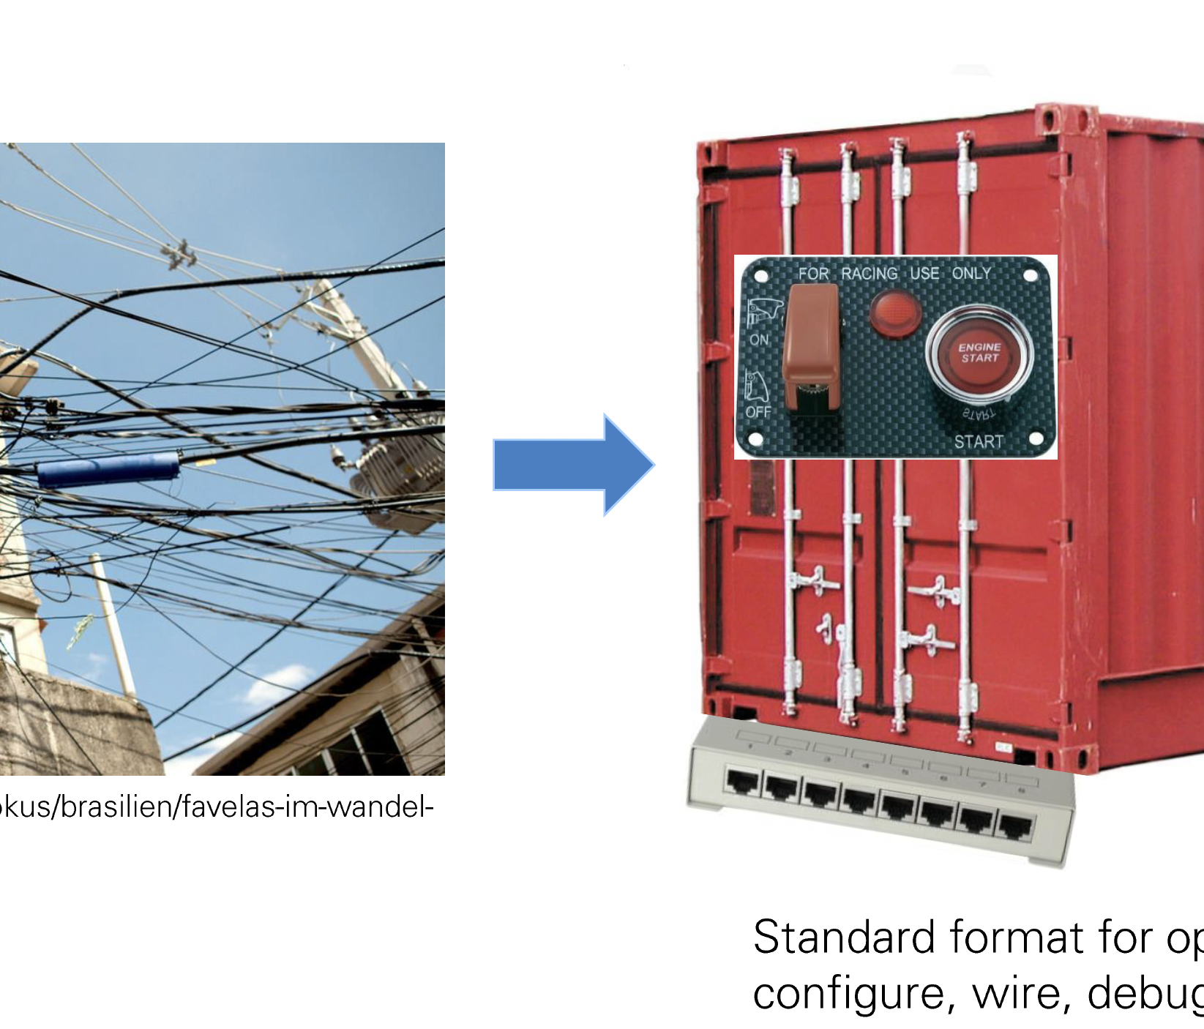
Why Virtualization?
What do you think?
Virtualization: Generation of virtual realities and mapping to the physical reality
Purposes:
Multiplicity: Generation of multiple realities within a physical reality
Decoupling: Resolve dependencies to the virtual reality
Isolation: Avoid physical side effects between virtual realities

Slide 5
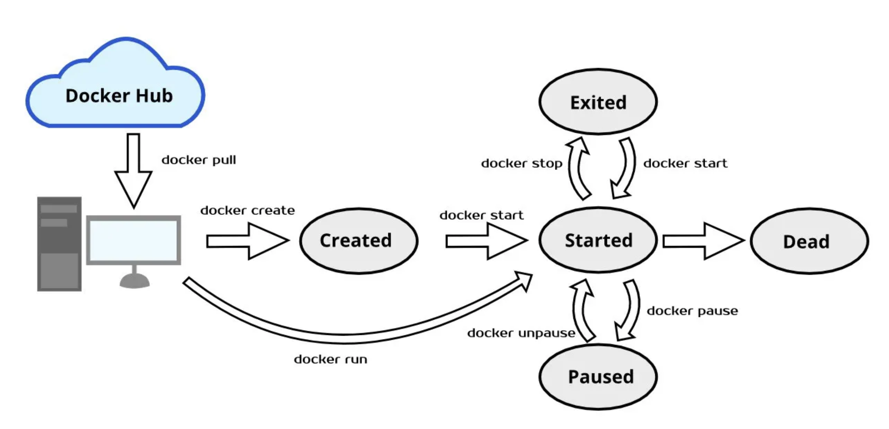
Meet Docker

Slide 6
Containerization vs. Hypervisor
Full Virtualization is heavy (virtual copy of entire os, significant RAM and CPU resources, difficult to dynamically change)
Software development more complex and less agile
Images big -> portability issues
Compatibility between VM solutions

Slide 7
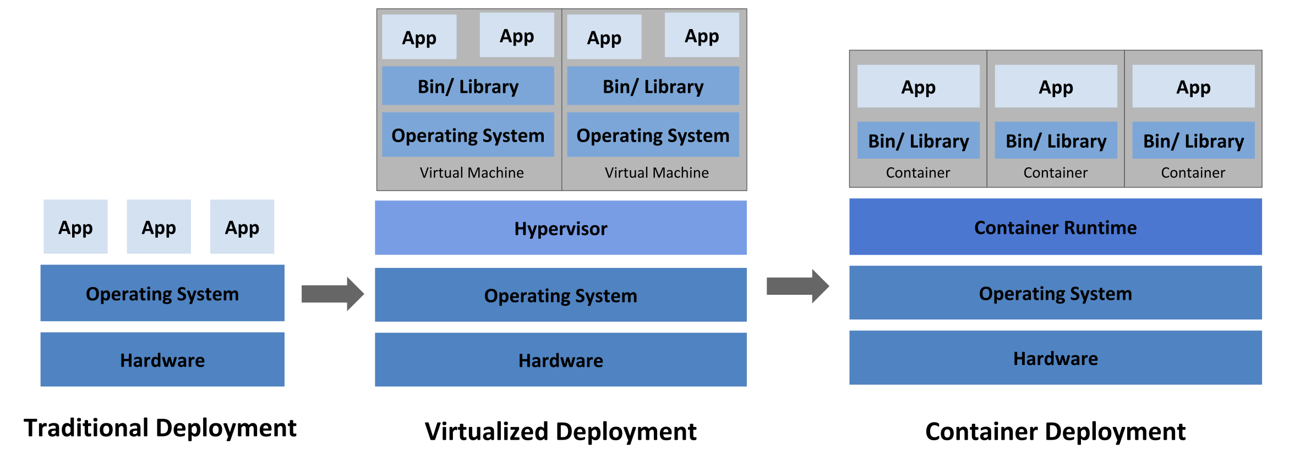
Deployment Types

Slide 8
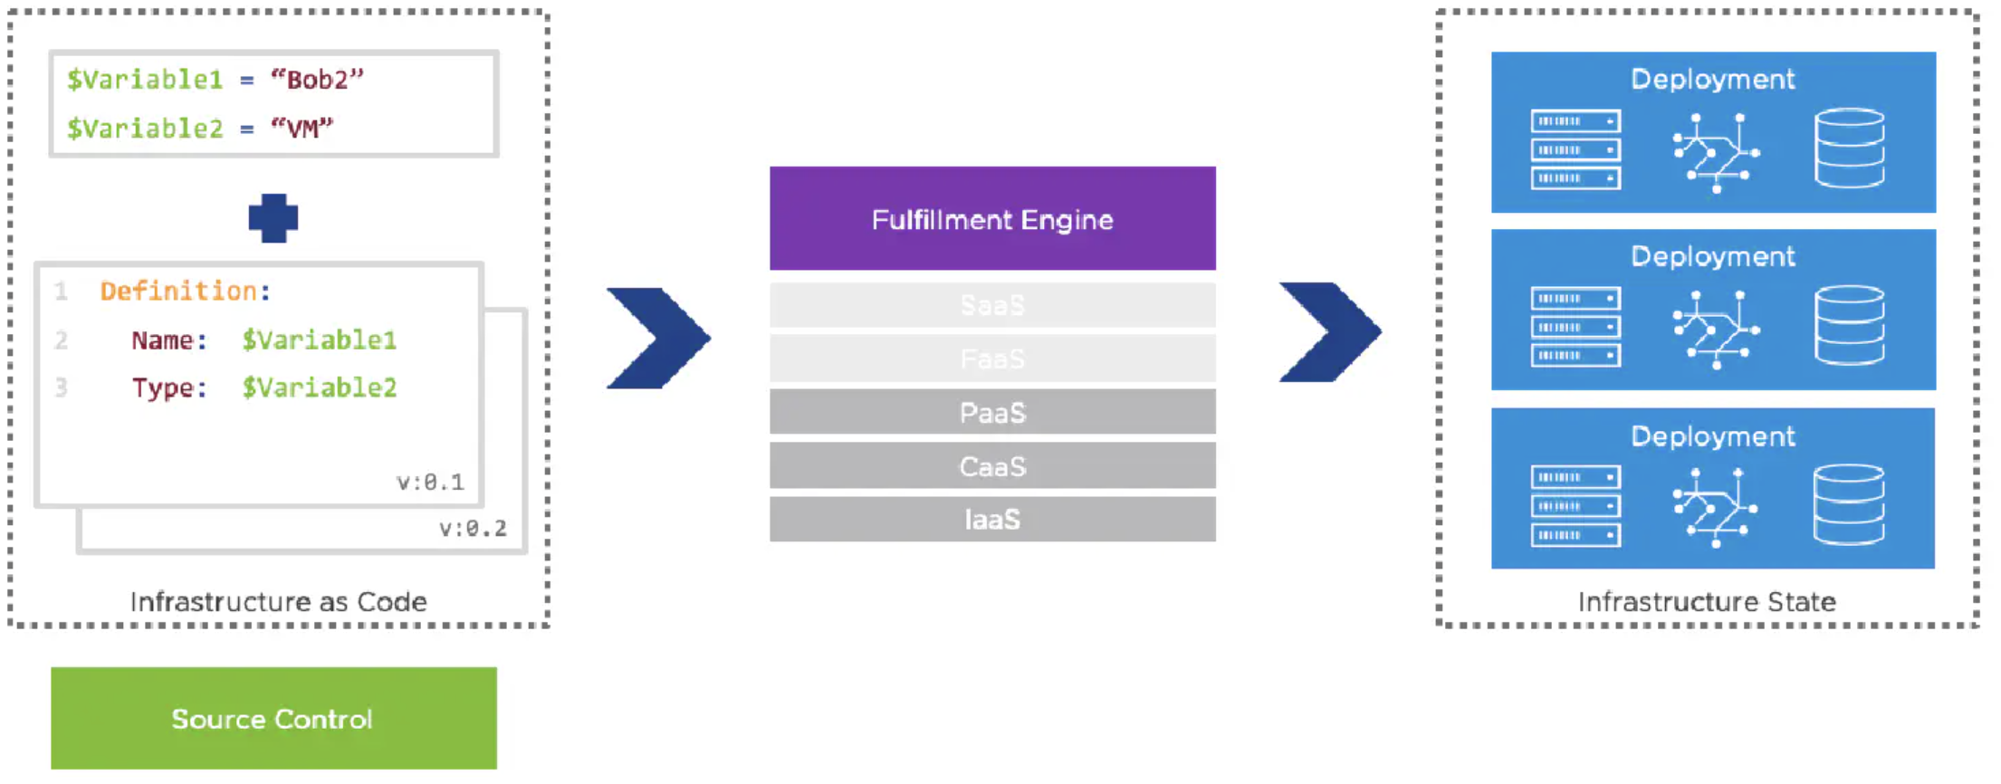
What is Infrastructure as Code?

Slide 9
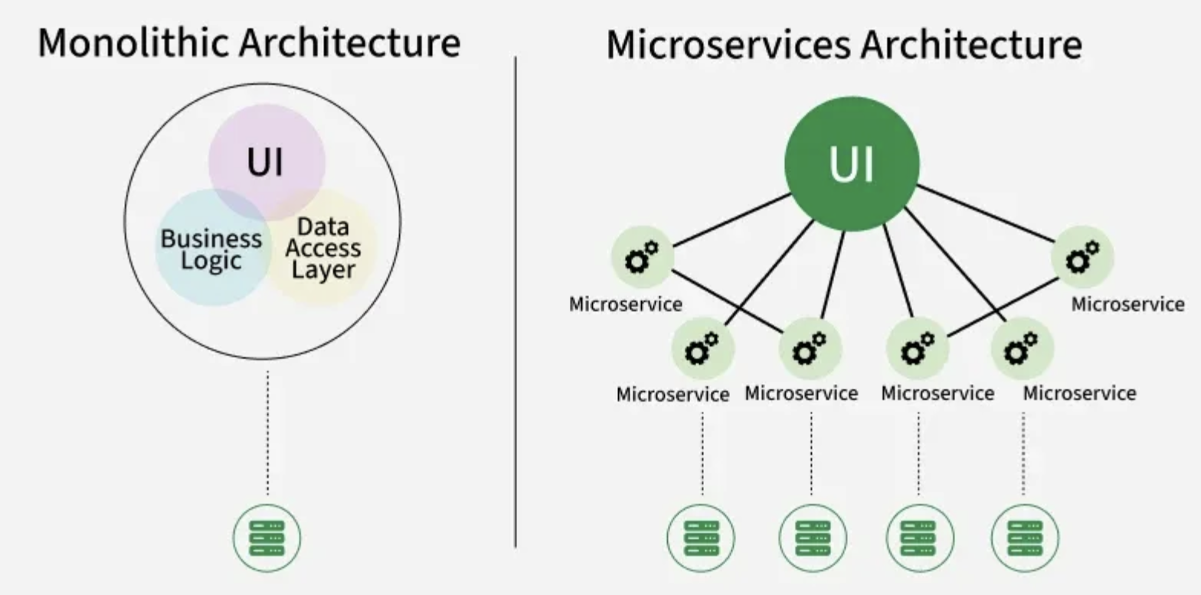
From Monoliths to Microservices

Slide 10
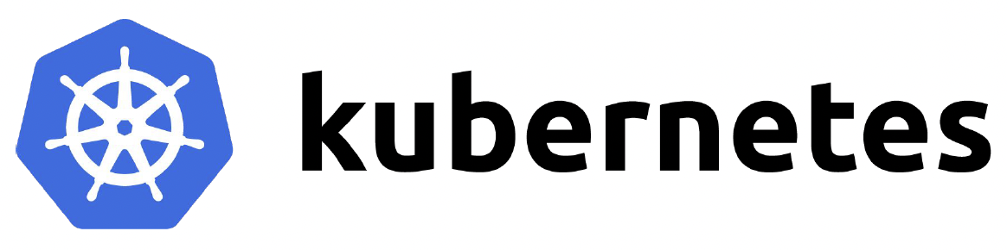
Orchestrator as interface between application as code and running application
Application Blueprint
Desired target state
Components (container)
Requirements, interfaces
Scheduling of containers with application-specific constraintes (e.g. start order, grouping, …)
Network connectivity between containers
Persistent storage for stateful containers
Auto scaling of containers
Re-scheduling of containers in case of failure
Orchestrator
Controlling Activities in the cluster

Slide 11
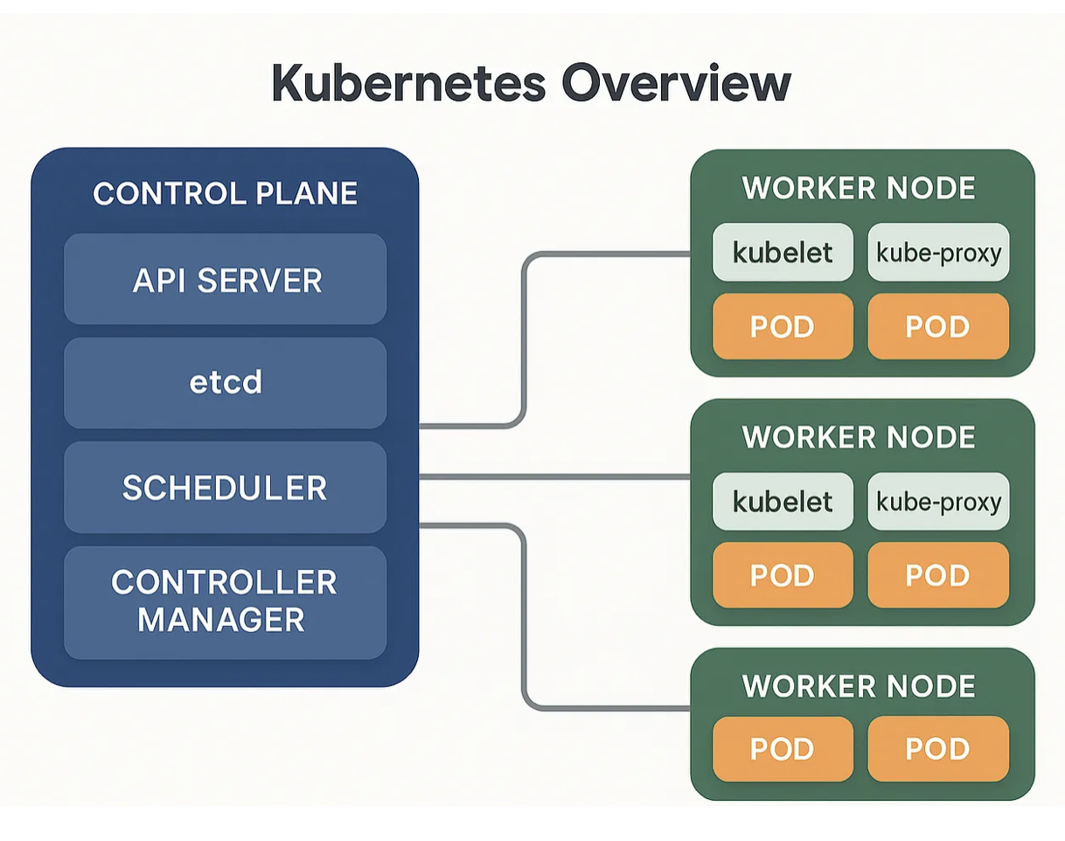
Meet Kubernetes
Source: https://medium.com/@salwan.mohamed/kubernetes-architecture-deep-dive-from-basics-to-advanced-concepts-part-2-3-baecceece974

Slide 12
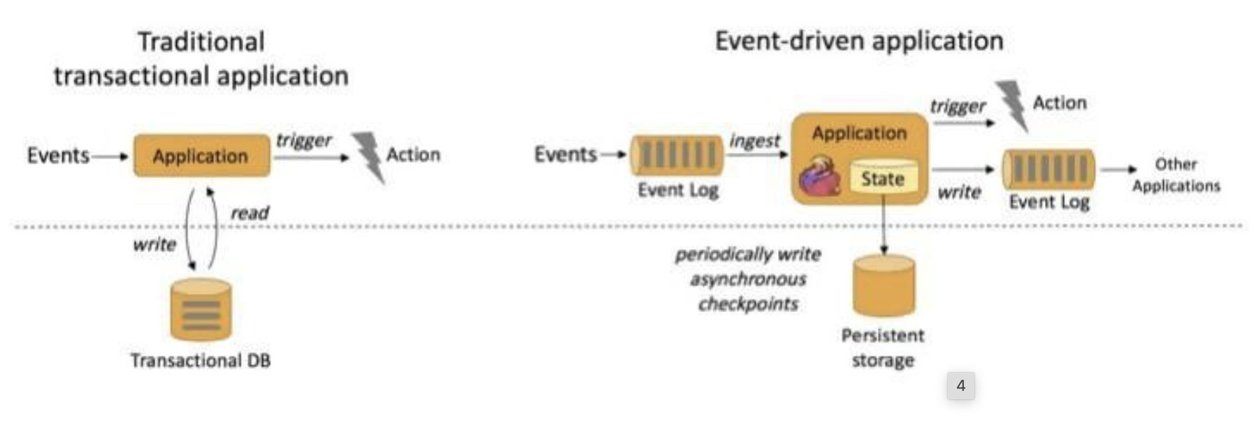
Towards Event-Driven Applications
Source: https://www.alibabacloud.com/blog/apache-flink-fundamentals-basic-concepts_595727

Slide 13
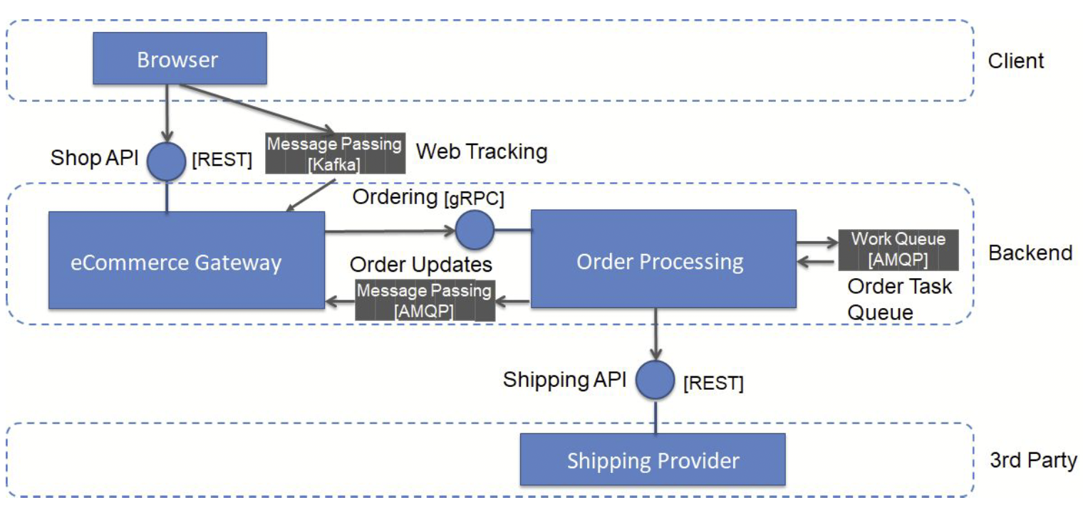
Example Architecture Event-Driven Design

Slide 14
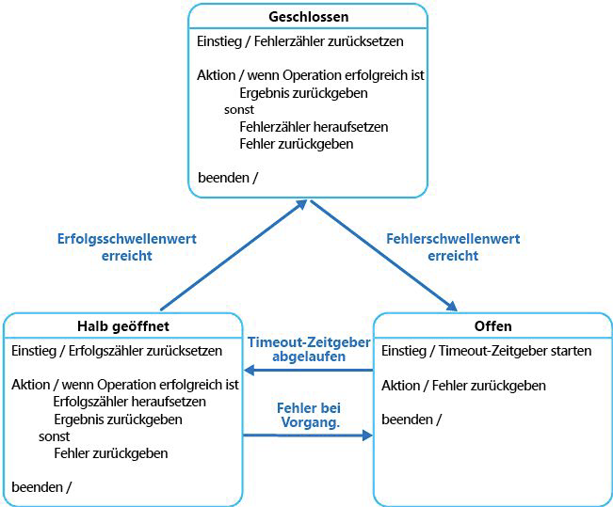
Resilience
Availability = MTTF / (MTTF + MTTR)
Example to increase resilience: circuit breaker
reliability
Resilience and diagnosability
Resilience = capability of a system to deal with unprecedented erroneous situations
Operational Excellence and Site Reliability Engineering

Slide 15


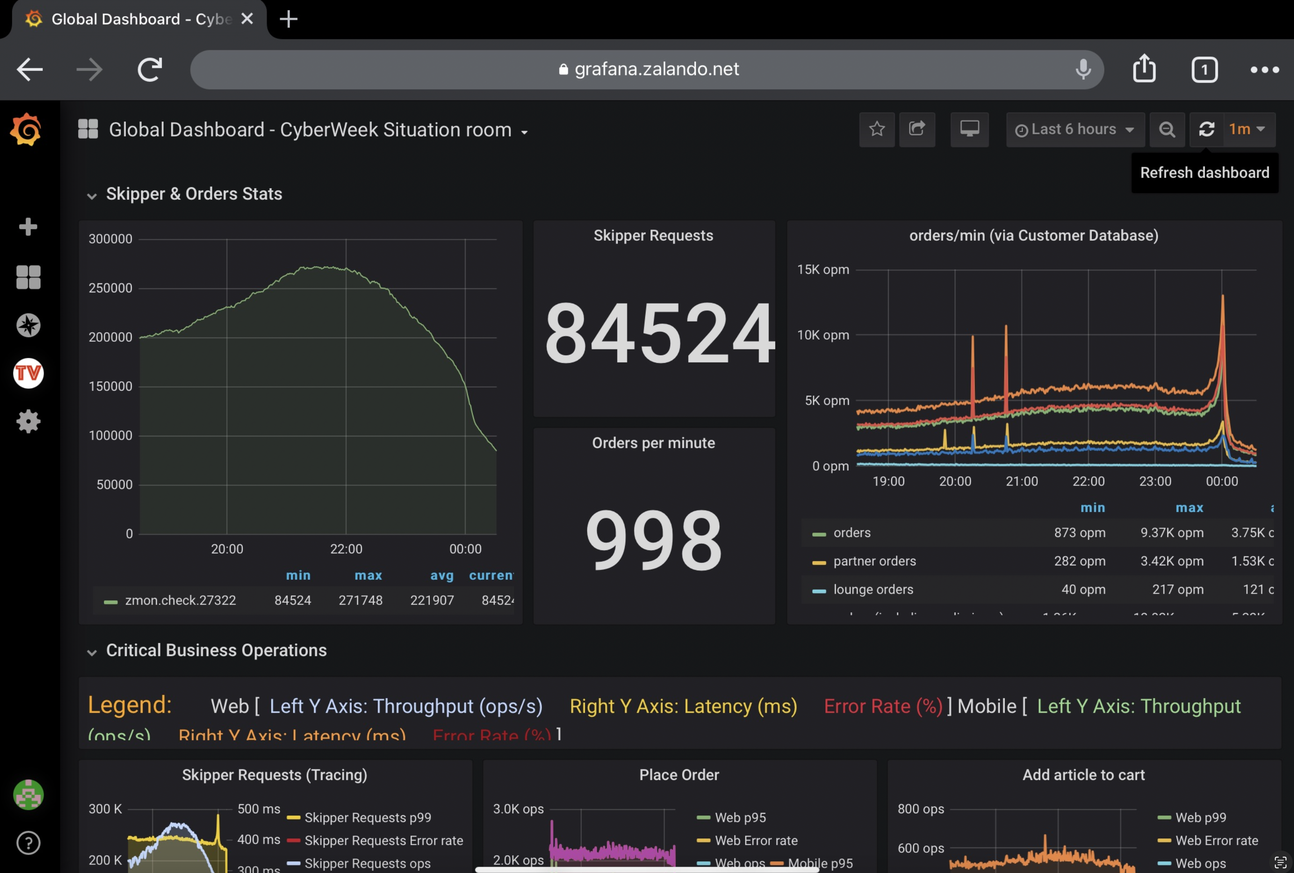
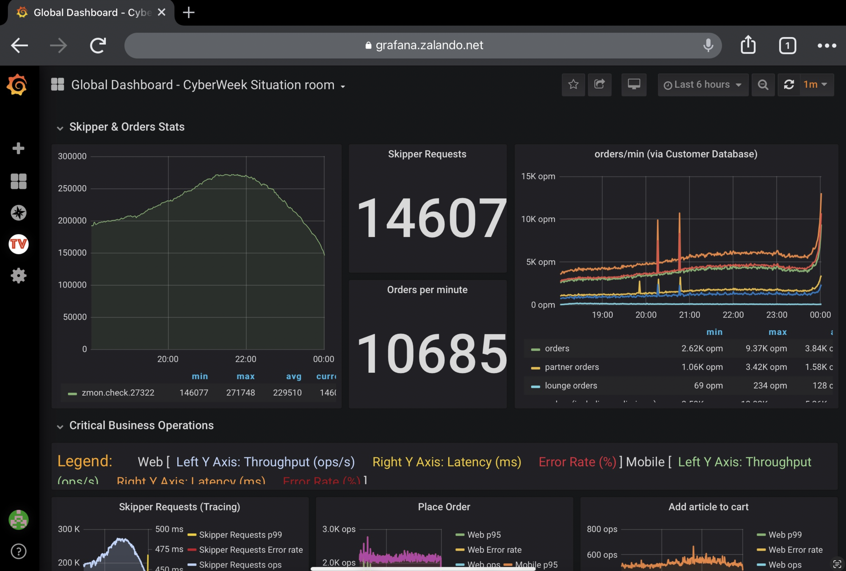
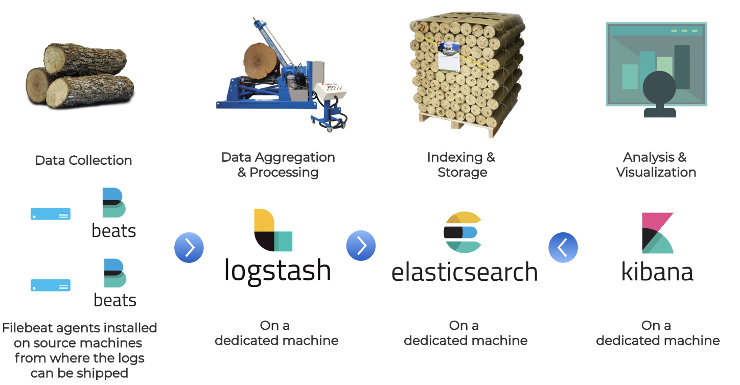
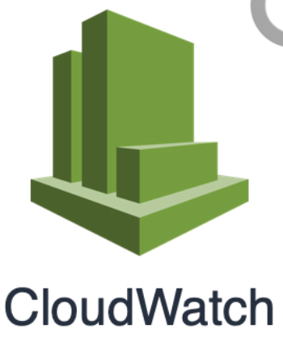
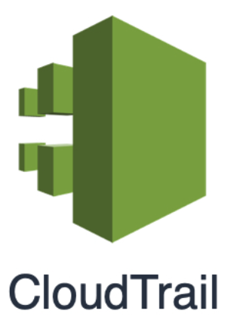

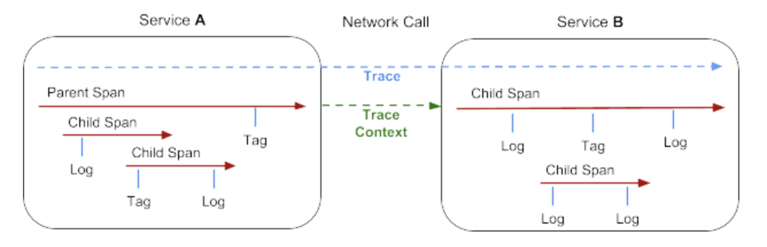
Diagnosability
Prometheus
Metrics
Gather
Visualise
Explore
Detect anomalies
communicate
Traces
Events and Logs
OpenTrace

Slide 17
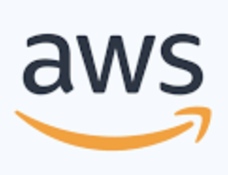
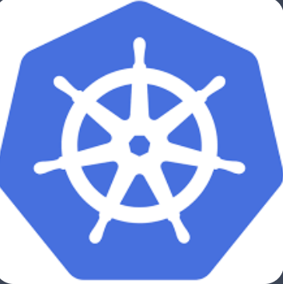
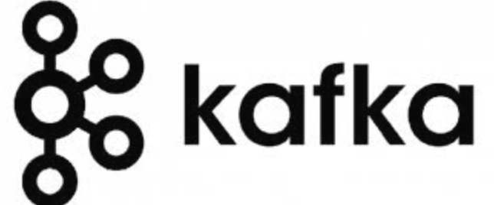
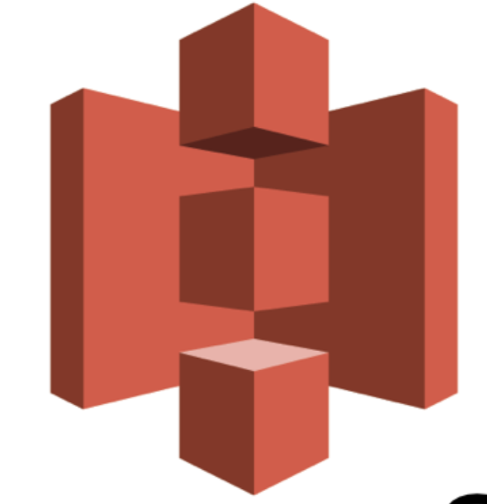
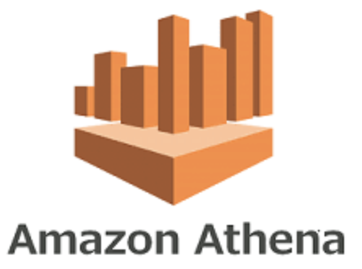
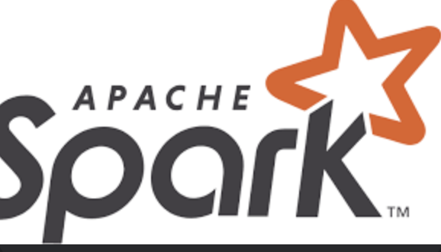
High Level Data Architecture at Zalando
Application
Events
Application
Application
Events
Queue
Application
Application
Events
Application
…

Slide 18
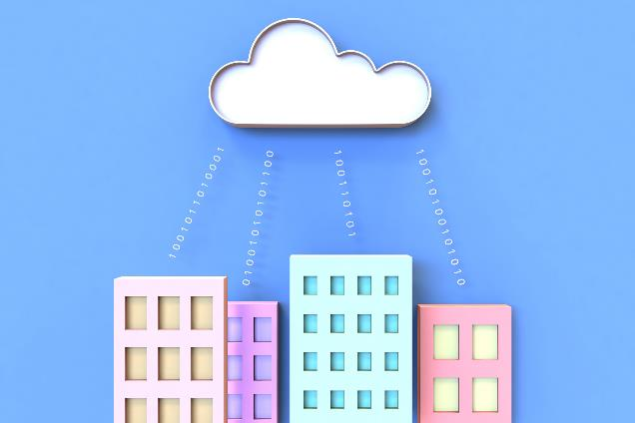
Definition Cloud Computing
Cloud computing is the on-demand provision of computing power, databases, storage, applications, and other IT resources over the internet with usage-based pricing.

Slide 19
Architectural need
Around 2000, Amazon was struggling to make its
new shopping website highly available and scalable.
Notes:
To understand what cloud architecting is and why it’s important, first consider an example of what software development is like in its absence.
Around 2000, Amazon was trying to create an ecommerce service that would enable third-party sellers to build their own online shopping sites on top of the Amazon ecommerce engine. The company was struggling to make its new shopping website highly available and scalable.

Slide 20
Origins of AWS
According to AWS CEO Andy Jassy, at the time, Amazon ecommerce tools were “a jumbled mess”
  Applications and architectures were built without proper planning
  It was difficult to separate services from each other
Solution: Amazon created a set of well-documented APIs, which became the company’s standard for service development
Notes:
In a TechCrunch interview about the genesis of AWS, AWS Chief Executive Officer (CEO) Andy Jassy said that in the beginning, the Amazon ecommerce tools were a “jumbled mess.” Applications and architectures were being built without proper planning. Jassy also said that it was “a huge challenge to separate the various services to make a centralized development platform.”
The solution to this problem was to create a set of well-documented application programming interfaces (APIs) to organize the development environment.

Slide 21
Problems persisted
Amazon still struggled to build applications quickly.
  Database, compute, and storage components took 3 months to build.
  Each team built their own resources, with no planning for scalability or re-usability.
Solution: Amazon built internal services to create highly available, scalable, and reliable architectures on top of its infrastructure. In 2006, Amazon started selling these services as AWS.
Notes:
However, Amazon still struggled to build applications quickly as the company grew and more software engineers were hired:
It took 3 months to build database, compute, and storage components for an entire project that was expected to take 3 months.
Each team built their own resources without planning for scalability or reusability.
The solution was to build internal services to create highly available, scalable, and reliable architectures on top of the Amazon infrastructure. In 2006, Amazon started selling these services as AWS.

Slide 22
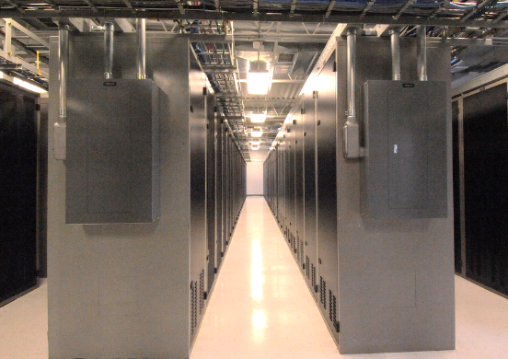

Infrastructure as software
Cloud computing allows you to no longer view your infrastructure as hardware, but to treat (and use) it as software.
Notes:
Cloud computing enables you to stop thinking of your infrastructure as hardware, and instead think of (and use) it as software. But what does this mean?

Slide 23
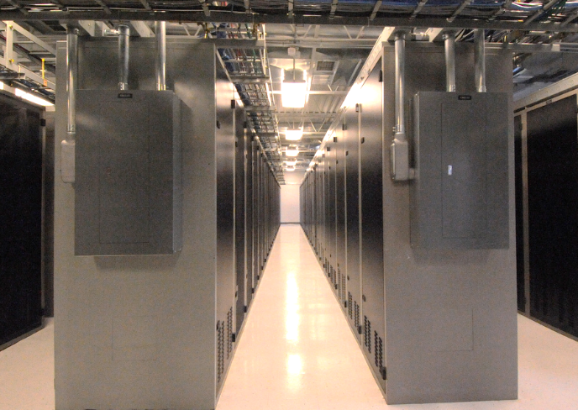
Traditional Model
Infrastructure as hardware
Hardware Solutions:
  Require space, personnel, physical security, planning, capital
  Long hardware procurement cycles
  Capacity needs to be estimated upfront
Notes:
In the traditional computing model, infrastructure is thought of as hardware. Hardware solutions are physical, which means they require space, staff, physical security, planning, and capital expenditure.
In addition to significant upfront investment, another prohibitive aspect of traditional computing is the long hardware procurement cycle that involves acquiring, provisioning, and maintaining on-premises infrastructure.
With a hardware solution, you must ask if there is enough resource capacity or sufficient storage to meet your needs, and you provision capacity by guessing theoretical maximum peaks. If you don’t meet your projected maximum peak, then you pay for expensive resources that stay idle. If you exceed your projected maximum peak, then you don’t have sufficient capacity to meet your needs. And if your needs change, then you must spend the time, effort, and money required to implement a new solution.
For example, if you wanted to provision a new website, you would need to buy the hardware, rack and stack it, put it in a data center, and then manage it or have someone else manage it. This approach is expensive and time-consuming.

Slide 24

Cloud Computing Model
Infrastructure as software
Software Solutions:
  Flexible
  They can be adapted more quickly, flexibly, and cost-effectively.
  It eliminates undifferentiated heavy-lifting tasks.
Notes:
By contrast, cloud computing enables you to think of your infrastructure as software. Software solutions are flexible. You can select the cloud services that best match your needs, provision and terminate those resources on-demand, and pay for what you use. You can elastically scale resources up and down in an automated fashion. With the cloud computing model, you can treat resources as temporary and disposable. The flexibility that cloud computing offers enables businesses to implement new solutions quickly and with low upfront costs.
Compared to hardware solutions, software solutions can change much more quickly, easily, and cost-effectively.
Cloud computing helps developers and IT departments avoid undifferentiated work like procurement, maintenance, and capacity planning, thus enabling them to focus on what matters most.
As cloud computing has grown in popularity, several different service models and deployment strategies have emerged to help meet the specific needs of different users. Each type of cloud service model and deployment strategy provides you with a different level of control, flexibility, and management. Understanding the differences between these cloud service models and deployment strategies can help you decide what set of services is right for your needs.

Slide 25

Cloud Service Models
IaaS
(infrastructure as a service)
PaaS
(platform as a service)
SaaS
(software as a service)
More control over IT resources
Less control
Notes:
There are three main cloud service models. Each model represents a different part of the cloud computing stack and gives you a different level of control over your IT resources:
Infrastructure as a service (IaaS): Services in this category are the basic building blocks for cloud IT and typically provide you with access to networking features, computers (virtual or on dedicated hardware), and data storage space. IaaS provides you with the highest level of flexibility and management control over your IT resources. It is the most similar to existing IT resources that many IT departments and developers are familiar with today.
Platform as a service (PaaS): Services in this category reduce the need for you to manage the underlying infrastructure (usually hardware and operating systems) and enable you to focus on the deployment and management of your applications.
Software as a service (SaaS): Services in this category provide you with a completed product that the service provider runs and manages. In most cases, software as a service refers to end-user applications. With a SaaS offering, you do not have to think about how the service is maintained or how the underlying infrastructure is managed. You need to think only about how you plan to use that particular piece of software. A common example of a SaaS application is web-based email, where you can send and receive email without managing feature additions to the email product or maintaining the servers and operating systems that the email program runs on.

Slide 26
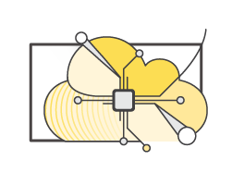
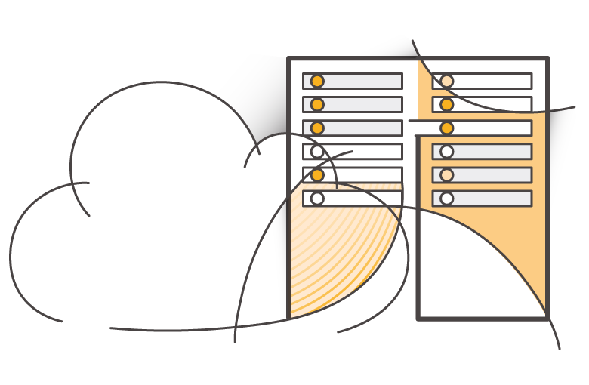
Cloud Computing Deployment Models
Cloud
Hybrid
On-premises
(private cloud)
Notes:
There are three main cloud computing deployment models, which represent the cloud environments that your applications can be deployed in:
Cloud: A cloud-based application is fully deployed in the cloud, and all parts of the application run in the cloud. Applications in the cloud have either been created in the cloud or have been migrated from an existing infrastructure to take advantage of the benefits of cloud computing (see https://aws.amazon.com/what-is-cloud-computing/). Cloud-based applications can be built on low-level infrastructure pieces or they can use higher-level services that provide abstraction from the management, architecting, and scaling requirements of core infrastructure.
Hybrid: A hybrid deployment is a way to connect infrastructure and applications between cloud-based resources and existing resources that are not located in the cloud. The most common method of hybrid deployment is between the cloud and existing on-premises infrastructure. This model enables an organization to extend and grow their infrastructure into the cloud while connecting cloud resources to internal systems.
On-premises: Deploying resources on-premises, using virtualization and resource management tools, is sometimes called private cloud. While on-premises deployment does not provide many of the benefits of cloud computing, it is sometimes sought for its ability to provide dedicated resources. In most cases, this deployment model is the same as legacy IT infrastructure, but it might also use application management and virtualization technologies to increase resource utilization.

Slide 27


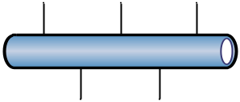


AWS vs. traditional deployment comparison
Traditional, on-premises IT space
AWS
Security
Security
groups
Firewalls
ACLs
Administrators
Network ACLs
IAM
Networking
Router
Network pipeline
Switch
Elastic Load Balancing
Amazon VPC
On-premises
servers
Compute
AMI
Amazon EC2 instances
Storage and
database
DAS
SAN
NAS
RDBMS
Amazon EBS
Amazon
EFS
Amazon
S3
Amazon RDS
Notes:
There are many similarities between AWS and the traditional, on-premises IT space:
AWS security groups, network access control lists (network ACLs), and AWS Identity and Access Management (IAM) are similar to firewalls, access control lists (ACLs), and administrators.
Elastic Load Balancing and Amazon Virtual Private Cloud (Amazon VPC) are similar to routers, network pipelines, and switches.
Amazon Machine Images (AMIs) and Amazon Elastic Compute Cloud (Amazon EC2) instances are similar to on-premises servers.
Amazon Elastic Block Store (Amazon EBS), Amazon Elastic File System (Amazon EFS), Amazon Simple Storage Service (Amazon S3), and Amazon Relational Database Service (Amazon RDS) are similar to direct attached storage (DAS), storage area networks (SAN), network attached storage (NAS), and a relational database management service (RDBMS).
With AWS services and features, you can do almost everything that you would want to do with a traditional data center.

Slide 28


Cloud Computing Advantages
Capital
Investment in data center based on estimate
Pay only what you consume

Slide 29
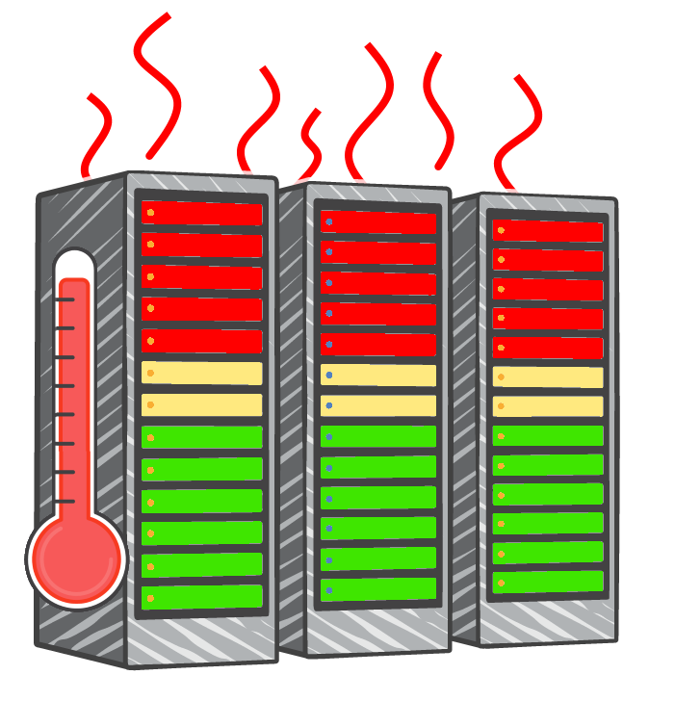
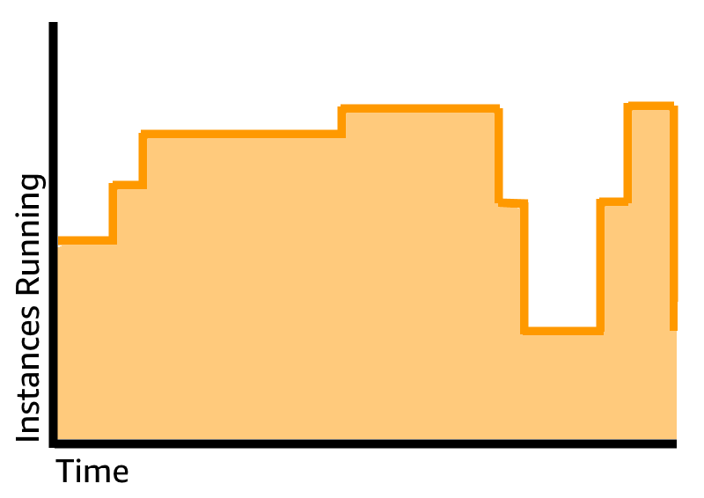
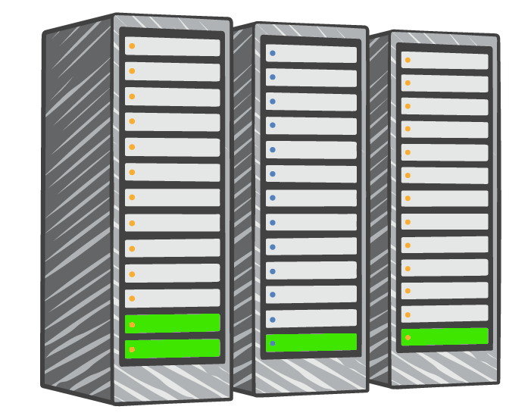
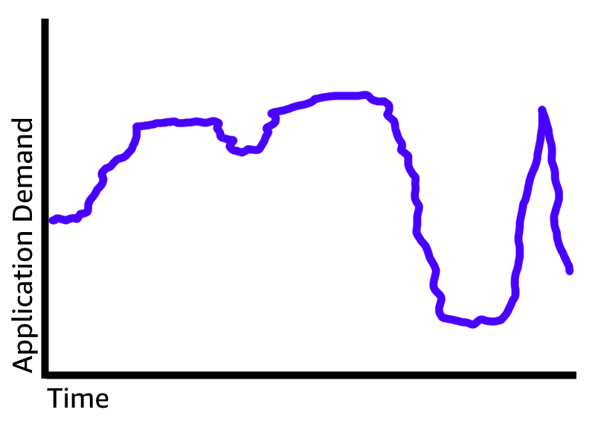

Cloud Computing Advantages
Overestimated
server capacity
Underestimated
server capacity
Scaling on demand

Slide 30
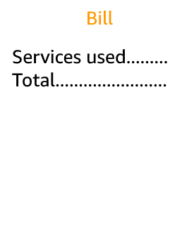


Economies of scale
Because of the aggregated usage across all customers, cloud providers can achieve greater economies of scale and pass these cost savings on to customers.
Cloud
Economies of scale
Savings

Slide 31
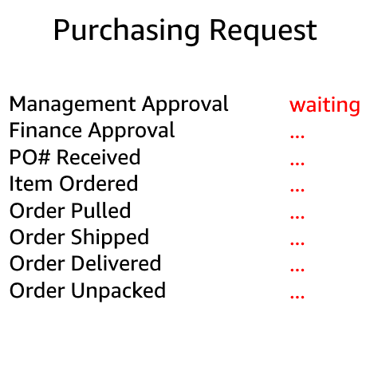

Greater speed and agility
Launch
Weeks between provisioning and availability of resources.
Minutes between provisioning and availability of resources.

Slide 32
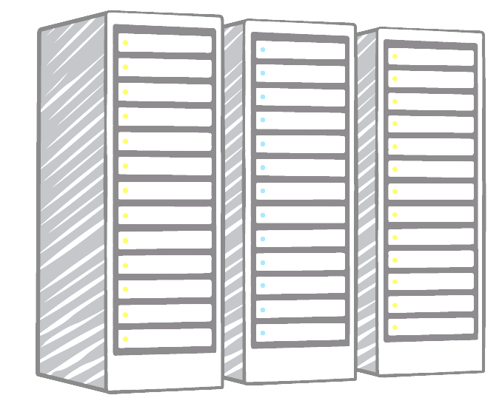



No data centers necessary anymore
Payroll
…. … .. …
…. … .. …
…. … .. …
…. … .. …
…. … .. …
…. … .. …
Utilities
…. … .. …
…. … .. …
…. … .. …
…. … .. …
…. … .. …
…. … .. …
Maintenance
…. … .. …
…. … .. …
…. … .. …
…. … .. …
…. … .. …
…. … .. …
Landscaping
…. … .. …
…. … .. …
…. … .. …
…. … .. …
…. … .. …
…. … .. …
Hardware
…. … .. …
…. … .. …
…. … .. …
…. … .. …
…. … .. …
…. … .. …
Investment
Running data centers
Business and customers

Slide 33
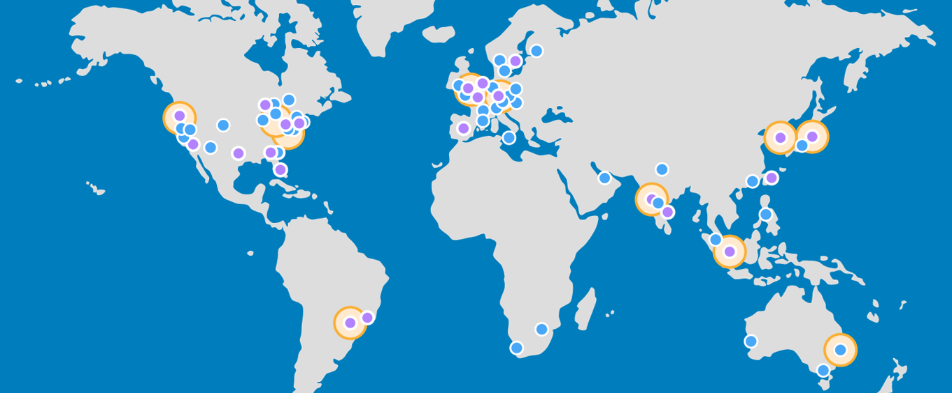

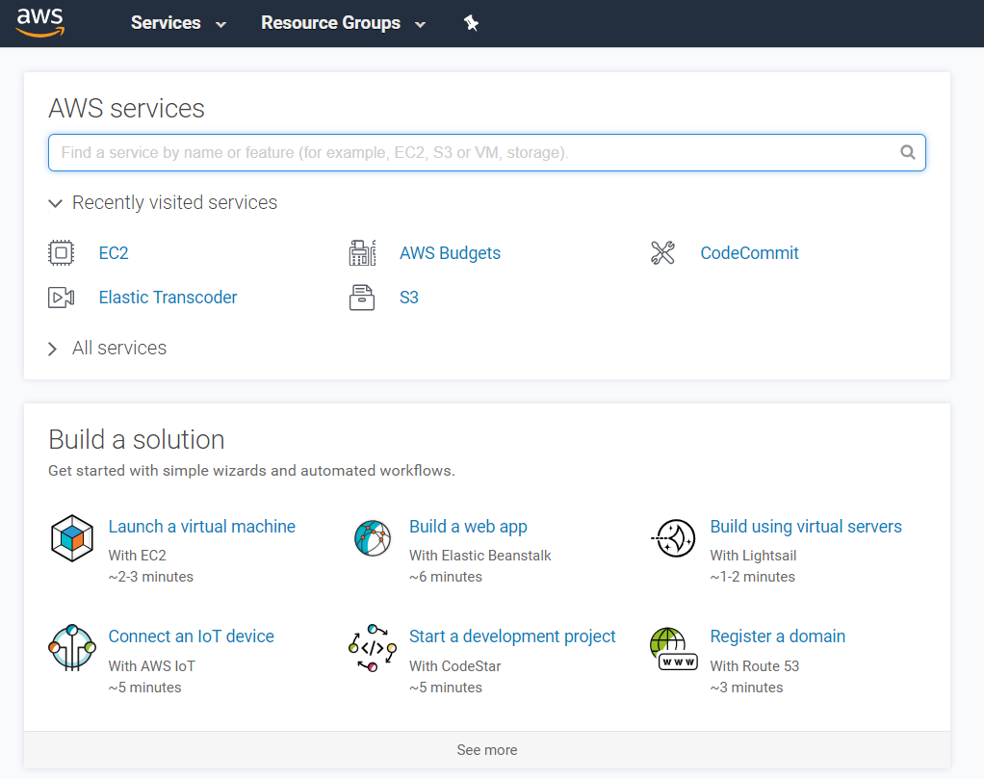
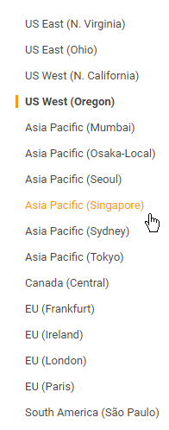
Global reach within minutes
Notes:
Advantage #6—Go global in minutes: You can deploy your application in multiple AWS Regions around the world with just a few clicks. As a result, you can provide a lower latency and better experience for your customers simply and at minimal cost.

Slide 34
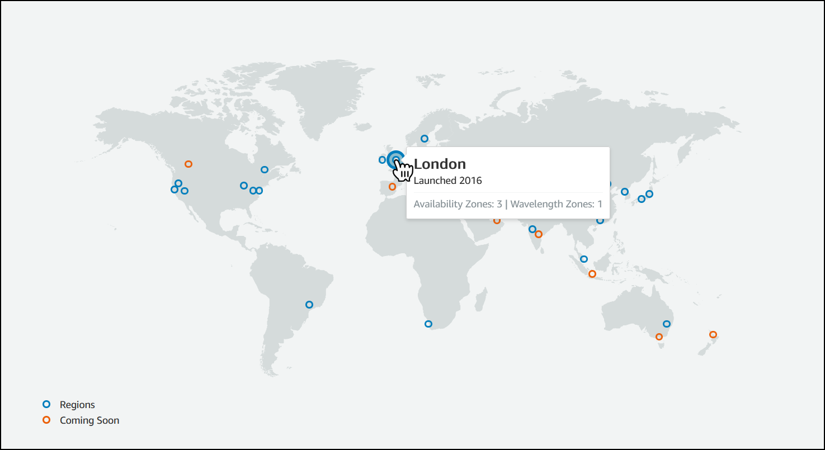
AWS Global Infrastructure
The AWS Global Infrastructure was designed and built to provide a flexible, reliable, scalable, and secure cloud computing environment with high-performance global networking.
  AWS Global Infrastructure Map: https://aws.amazon.com/about-aws/global-infrastructure/#AWS_Global_Infrastructure_Map
  Regions and Availability Zones: https://aws.amazon.com/about-aws/global-infrastructure/regions_az/
Notes:
To learn more about the AWS Regions that are currently available, use one of the following links:
https://aws.amazon.com/about-aws/global-infrastructure/#AWS_Global_Infrastructure_Map
https://aws.amazon.com/about-aws/global-infrastructure/regions_az/
These resources are updated frequently to show current and planned AWS infrastructure.

Slide 35
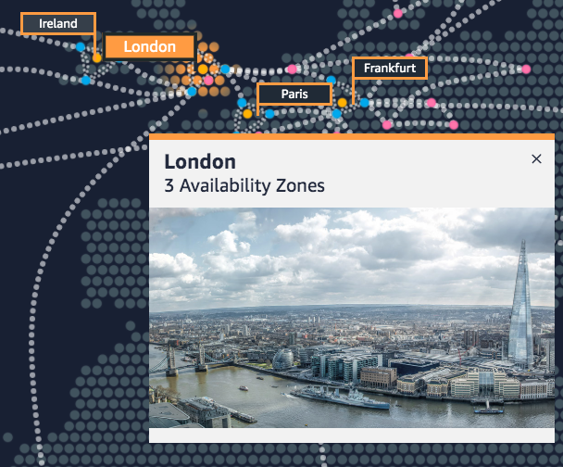
AWS Regions
An AWS Region is a geographic area.
Data replication across regions is controlled by AWS
Communication between regions uses the AWS backbone network infrastructure.
Each region provides full redundancy and network connectivity.
A region typically consists of two or more Availability Zones.
Example: London Region
Notes:
The AWS Cloud infrastructure is built around Regions. AWS has 22 Regions worldwide. An AWS Region is a physical geographical location with one or more Availability Zones. Availability Zones in turn consist of one or more data centers.
To achieve fault tolerance and stability, Regions are isolated from one another. Resources in one Region are not automatically replicated to other Regions. When you store data in a specific Region, it is not replicated outside that Region.
It is your responsibility to replicate data across Regions, if your business needs require it.
AWS Regions that were introduced before March 20, 2019 are enabled by default. Regions that were introduced after March 20, 2019—such as Asia Pacific (Hong Kong) and Middle East (Bahrain)—are disabled by default. You must enable these Regions before you can use them. You can use the AWS Management Console to enable or disable a Region.
Some Regions have restricted access. An Amazon AWS (China) account provides access to the Beijing and Ningxia Regions only. To learn more about AWS in China, see: https://www.amazonaws.cn/en/about-aws/china/. The isolated AWS GovCloud (US) Region is designed to allow US government agencies and customers to move sensitive workloads into the cloud by addressing their specific regulatory and compliance requirements.
For accessibility: Snapshot from the infrastructure.aws website that shows a picture of downtown London including the Tower Bridge and the Shard. It notes that there are three Availability Zones in the London region. End of accessibility description.

Slide 36
How to select a region?
Data governance, legal requirements
Proximity to customers (latency)
Services available within the Region
Costs (vary by Region)
Notes:
There are a few factors that you should consider when you select the optimal Region or Regions where you store data and use AWS services.
One essential consideration is data governance and legal requirements. Local laws might require that certain information be kept within geographical boundaries. Such laws might restrict the Regions where you can offer content or services. For example, consider the European Union (EU) Data Protection Directive.
All else being equal, it is generally desirable to run your applications and store your data in a Region that is as close as possible to the user and systems that will access them. This will help you reduce latency. CloudPing is one website that you can use to test latency between your location and all AWS Regions. To learn more about CloudPing, see: http://www.cloudping.info/
Keep in mind that not all services are available in all Regions. To learn more, see: https://aws.amazon.com/about-aws/global-infrastructure/regional-product-services/?p=tgi&loc=4.
Finally, there is some variation in the cost of running services, which can depend on which Region you choose. For example, as of this writing, running an On-Demand t3.medium size Amazon Elastic Compute Cloud (Amazon EC2) Linux instance in the US East (Ohio) Region costs $0.0416 per hour, but running the same instance in the Asia Pacific (Tokyo) Region costs $0.0544 per hour.

Slide 37
Availability Zones
AWS Cloud
Each region has multiple Availability Zones.
Each Availability Zone is a fully isolated partition of the AWS infrastructure.
Availability Zones consist of separate data centers.
They are designed for fault isolation.
They are connected to other Availability Zones via private high-speed networks.
For resilience reasons, AWS recommends replicating data and resources across Availability Zones.
Region eu-west-1
Availability Zone eu-west-1a
Data center
Data center
Data center
Availability Zone eu-west-1b
Availability Zone eu-west-1c
Notes:
Each AWS Region has multiple, isolated locations that are known as Availability Zones.
Each Availability Zone provides the ability to operate applications and databases that are more highly available, fault-tolerant, and scalable than would be possible with a single data center. Each Availability Zone can include multiple data centers (typically three), and at full-scale, they can include hundreds of thousands of servers. They are fully isolated partitions of the AWS Global Infrastructure. Availability Zones have their own power infrastructure, and they are physically separated by many kilometers from other Availability Zones—though all Availability Zones are within 100 km of each other.
All Availability Zones are interconnected with high-bandwidth, low-latency networking over fully redundant, dedicated fiber that provides high-throughput between Availability Zones. The network accomplishes synchronous replication between Availability Zones.
Availability Zones help build highly available applications. When an application is partitioned across Availability Zones, companies are better isolated and protected from issues such as lightning, tornadoes, earthquakes, and more.
You are responsible for selecting the Availability Zones where your systems will reside. Systems can span multiple Availability Zones. AWS recommends replicating across Availability Zones for resiliency. You should design your systems to survive the temporary or prolonged failure of an Availability Zone if a disaster occurs.

Slide 38

AWS Data Centers
AWS data centers are designed with security in mind.
Data centers are where data is stored and data processing takes place.
Each data center has redundant power, networking, and connectivity and is housed in a separate facility.
A data center typically contains between 50,000 and 80,000 physical servers.
Notes:
The foundation for the AWS infrastructure is the data centers. Customers do not specify a data center for the deployment of resources. Instead, an Availability Zone is the most granular level of specification that a customer can make. However, a data center is the location where the actual data resides. Amazon operates state-of-the-art, highly available data centers. Although rare, failures can occur that affect the availability of instances in the same location. If you host all your instances in a single location that is affected by such a failure, none of your instances will be available.
Data centers are securely designed with several factors in mind:
Each location is carefully evaluated to mitigate environmental risk.
Data centers have a redundant design that anticipates and tolerates failure while maintaining service levels.
To ensure availability, critical system components are backed up across multiple Availability Zones.
To ensure capacity, AWS continuously monitors service usage to deploy infrastructure to support availability commitments and requirements.
Data center locations are not disclosed and all access to them is restricted.
In case of failure, automated processes move data traffic away from the affected area.
AWS uses custom network equipment sourced from multiple original device manufacturers (ODMs). ODMs design and manufacture products based on specifications from a second company. The second company then rebrands the products for sale.

Slide 39




AWS infrastructure features
• Elasticity and scalability
• Elastic infrastructure; dynamic capacity adjustment
• Scalable infrastructure; adapts to growth
• Fault tolerance
• Continues to operate correctly even in the event of a failure
• Built-in redundancy of components
• High availability
• High level of operational performance
• Minimized downtime
• No human intervention required
Physically distinct
Backup generators
Data center
Data center
Data center
Data center
Data center
Data center
Data center
Data center
Availability Zone
Availability Zone
Network connectivity
Data center
Data center
Data center
Data center
Availability Zone
Uninterruptible power supply
Cooling equipment
AWS Region
Notes:
Now that you have a good understanding of the major components that comprise the AWS Global Infrastructure, let's consider the benefits provided by this infrastructure.
The AWS Global Infrastructure has several valuable features:
First, it is elastic and scalable. This means resources can dynamically adjust to increases or decreases in capacity requirements. It can also rapidly adjust to accommodate growth.
Second, this infrastructure is fault tolerant, which means it has built-in component redundancy which enables it to continue operations despite a failed component.
Finally, it requires minimal to no human intervention, while providing high availability with minimal down time.

Slide 40
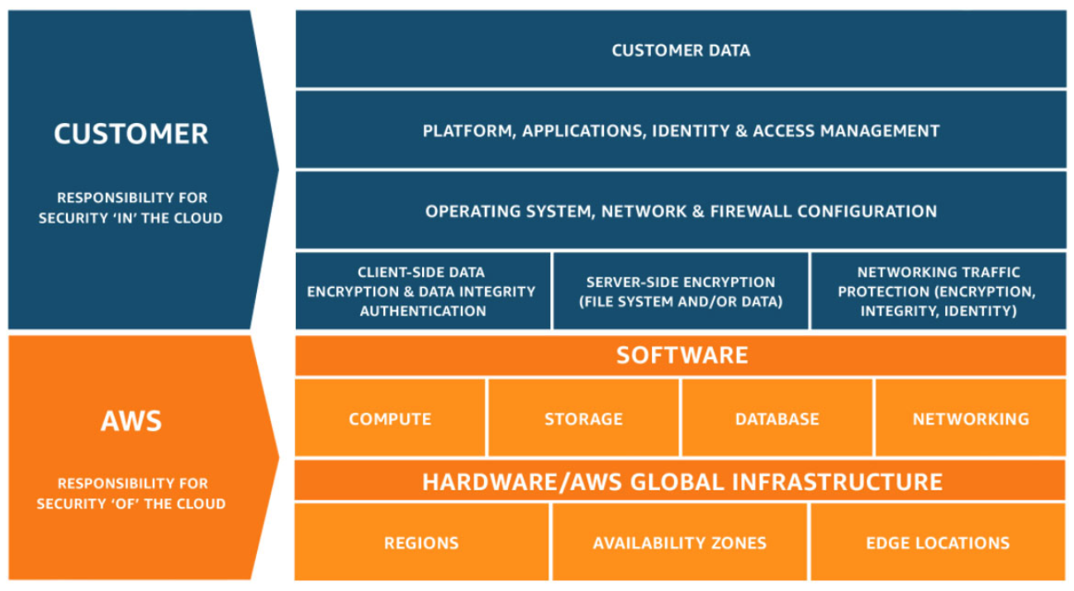
AWS shared responsibility model
Notes:
Security and compliance are a shared responsibility between AWS and the customer. This shared responsibility model is designed to help relieve the customer’s operational burden. At the same time, to provide the flexibility and customer control that enables the deployment of customer solutions on AWS, the customer remains responsible for some aspects of the overall security. The differentiation of who is responsible for what is commonly referred to as security “of” the cloud versus security “in” the cloud.
AWS operates, manages, and controls the components from the software virtualization layer down to the physical security of the facilities where AWS services operate. AWS is responsible for protecting the infrastructure that runs all the services that are offered in the AWS Cloud. This infrastructure is composed of the hardware, software, networking, and facilities that run the AWS Cloud services.
The customer is responsible for the encryption of data at rest and data in transit. The customer should also ensure that the network is configured for security and that security credentials and logins are managed safely. Additionally, the customer is responsible for the configuration of security groups and the configuration of the operating system that run on compute instances that they launch (including updates and security patches).

Slide 41

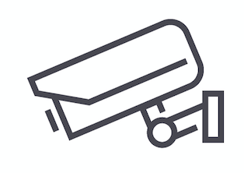
AWS responsibility: Security of the cloud
AWS services
AWS responsibilities:
Physical security of data centers
Controlled, on-demand access
Hardware and software infrastructure
Decommissioning of storage, logging access to the host operating system (OS), and monitoring
Network infrastructure
Intrusion detection
Virtualization infrastructure
Instance isolation
Compute
Storage
Database
Networking
AWS Global
Infrastructure
Regions
Availability Zones
Edge locations
Notes:
AWS is responsible for security of the cloud. But what does that mean?
Under the AWS shared responsibility model, AWS operates, manages, and controls the components from the bare metal host operating system and hypervisor virtualization layer down to the physical security of the facilities where the services operate. It means that AWS is responsible for protecting the global infrastructure that runs all the services that are offered in the AWS Cloud. The global infrastructure includes AWS Regions, Availability Zones, and edge locations.
AWS is responsible for the physical infrastructure that hosts your resources, including:
Physical security of data centers with controlled, need-based access; located in nondescript facilities, with 24/7 security guards; two-factor authentication; access logging and review; video surveillance; and disk degaussing and destruction.
Hardware infrastructure, such as servers, storage devices, and other appliances that AWS relies on.
Software infrastructure, which hosts operating systems, service applications, and virtualization software.
Network infrastructure, such as routers, switches, load balancers, firewalls, and cabling. AWS also continuously monitors the network at external boundaries, secures access points, and provides redundant infrastructure with intrusion detection.
Protecting this infrastructure is the top priority for AWS. While you cannot visit AWS data centers or offices to see this protection firsthand, Amazon provides several reports from third-party auditors who have verified our compliance with a variety of computer security standards and regulations.

Slide 42
Customer responsibility: Security in the cloud
Customer responsibilities:
Amazon Elastic Compute Cloud (Amazon EC2) instance operating system
Including patching and maintenance
Applications
Passwords, role-based access, etc.
Security group configuration
Operating system– or host-based firewalls
  Including intrusion detection or prevention systems
Network configurations
Account management
Login and permission settings for each user
Customer data
Applications, IAM
Operating system, network, and firewall configuration
Client-side data
encryption and data integrity authentication
Server-side encryption
(file system or data)
Network traffic protection
(encryption, integrity, identity)
Customer-configurable
Notes:
While the cloud infrastructure is secured and maintained by AWS, customers are responsible for security of everything they put in the cloud.
The customer is responsible for what is implemented by using AWS services and for the applications that are connected to AWS. The security steps that you must take depend on the services that you use and the complexity of your system.
Customer responsibilities include selecting and securing any instance operating systems, securing the applications that are launched on AWS resources, security group configurations, firewall configurations, network configurations, and secure account management.
When customers use AWS services, they maintain complete control over their content. Customers are responsible for managing critical content security requirements, including:
What content they choose to store on AWS
Which AWS services are used with the content
In what country that content is stored
The format and structure of that content and whether it is masked, anonymized, or encrypted
Who has access to that content and how those access rights are granted, managed, and revoked
Customers retain control of what security they choose to implement to protect their own data, environment, applications, IAM configurations, and operating systems.

Slide 43
Service Characteristics and Responsibilities (1 of 2)
Example services managed by the customer
Infrastructure as a Service (IaaS)
The customer has more flexibility in configuring network and storage settings.
The customer is responsible for managing additional aspects of security.
The customer configures access controls.
Platform as a Service (PaaS)
The customer does not need to manage the underlying infrastructure.
AWS handles the operating system, database patching, firewall configuration, and disaster recovery.
The customer can focus on managing code or data.
Amazon
EC2
Amazon Elastic Block Store (Amazon EBS)
Amazon
Virtual Private Cloud (Amazon VPC)
Example services managed by AWS
AWS
Lambda
Amazon
Relational Database Service (Amazon RDS)
AWS Elastic Beanstalk
Notes:
Infrastructure as a service (IaaS) refers to services that provide basic building blocks for cloud IT, typically including access to configure networking, computers (virtual or on dedicated hardware), and data storage space. Cloud services that can be characterized as IaaS provide the customer with the highest level of flexibility and management control over IT resources. IaaS services are most similar to existing on-premises computing resources that many IT departments are familiar with today.
AWS services—such as Amazon EC2—can be categorized as IaaS and thus require the customer to perform all necessary security configuration and management tasks. Customers who deploy EC2 instances are responsible for managing the guest operating system (including updates and security patches), any application software that is installed on the instances, and the configuration of the security groups that were provided by AWS.
Platform as a service (PaaS) refers to services that remove the need for the customer to manage the underlying infrastructure (hardware, operating systems, etc.). PaaS services enable the customer to focus entirely on deploying and managing applications. Customers don’t need to worry about resource procurement, capacity planning, software maintenance, or patching.
AWS services such as AWS Lambda and Amazon RDS can be categorized as PaaS because AWS operates the infrastructure layer, the operating system, and platforms. Customers only need to access the endpoints to store and retrieve data. With PaaS services, customers are responsible for managing their data, classifying their assets, and applying the appropriate permissions. However, these service act more like managed services, with AWS handling a larger portion of the security requirements. For these services, AWS handles basic security tasks—such as operating system and database patching, firewall configuration, and disaster recovery.

Slide 44
Service Characteristics and Responsibilities (2 of 2)
SaaS examples
Software as a Service (SaaS)
Software is centrally hosted.
Licensed on a subscription model or on a pay-as-you-go basis.
Access to the services is typically provided via a web browser, a mobile app, or an application programming interface (API).
Customers do not need to manage the infrastructure that supports the service.
AWS Trusted
Advisor
AWS Shield
Amazon Chime
Notes:
Software as a service (SaaS) refers to services that provide centrally hosted software that is typically accessible via a web browser, mobile app, or application programming interface (API). The licensing model for SaaS offerings is typically subscription or pay as you go. With SaaS offerings, customers do not need to manage the infrastructure that supports the service. Some AWS services—such as AWS Trusted Advisor, AWS Shield, and Amazon Chime—could be categorized as SaaS offerings, given their characteristics.
AWS Trusted Advisor is an online tool that analyzes your AWS environment and provides real-time guidance and recommendations to help you provision your resources by following AWS best practices. The Trusted Advisor service is offered as part of your AWS Support plan. Some of the Trusted Advisor features are free to all accounts, but Business Support and Enterprise Support customers have access to the full set of Trusted Advisor checks and recommendations.
AWS Shield is a managed distributed denial of service (DDoS) protection service that safeguards applications running on AWS. It provides always-on detection and automatic inline mitigations that minimize application downtime and latency, so there is no need to engage AWS Support to benefit from DDoS protection. AWS Shield Advanced is available to all customers. However, to contact the DDoS Response Team, customers must have either Enterprise Support or Business Support from AWS Support.
Amazon Chime is a communications service that enables you to meet, chat, and place business calls inside and outside your organization, all using a single application. It is a pay-as-you-go communications service with no upfront fees, commitments, or long-term contracts.

Slide 45
AWS Service Categories
Analytics
Application
Integration
AR and VR
Blockchain
Business
Applications
Compute
Cost
Management
Customer
Engagement
Database
Developer Tools
End User
Computing
Game Tech
Internet
of Things
Machine Learning
Management and
Governance
Media Services
Migration and
Transfer
Mobile
Networking and
Content Delivery
Robotics
Satellite
Security, Identity, and
Compliance
Storage
Notes:
AWS services fall under different categories, and each category contains one or more services. You can select the services that you want from these different categories to build your solutions.

Slide 46


AWS Foundational Services
Applications
Virtual desktops
Collaboration and sharing
Databases
Analytics
Application services
Deployment and management
Mobile Services
Cluster computing
Relational
Queuing
Containers
Identity
Platform
Services
Real-time
Orchestration
DevOps tools
Sync
NoSQL
Data warehouse
App Streaming
Resource templates
Mobile Analytics
Transcoding
Email
Usage tracking
Caching
Data workflows
Notifications
Search
Monitoring and logs
Compute (virtual, automatic scaling, and load balancing)
Networking
Storage (object, block, and archive)
Foundation
Services
Infrastructure
Regions
Availability Zones
Edge locations
Notes:
As discussed previously, the AWS Global Infrastructure can be broken down into three elements: Regions, Availability Zones, and Points of Presence, which include edge locations. This infrastructure provides the platform for a broad set of services, such as networking, storage, compute services, and databases—and these services are delivered as an on-demand utility that is available in seconds, with pay-as-you-go pricing.
For accessibility: Marketing diagram showing infrastructure at the bottom, consisting of Regions, Availability Zones, and edge locations. The next level up is labeled Foundational Services and includes graphics for compute, networking, and storage. That level is highlighted. Next level up is platform services that includes databases, analytics, app services, deployment and management, and mobile services. Top layer is labeled applications and includes virtual desktops and collaboration and sharing. End of accessibility description.

Slide 47
AWS Service Categories
Analytics
Application
Integration
AR and VR
Blockchain
Business
Applications
Compute
Cost
Management
Customer
Engagement
Database
Developer Tools
End User
Computing
Game Tech
Internet
of Things
Machine Learning
Management and
Governance
Media Services
Migration and
Transfer
Mobile
Networking and
Content Delivery
Robotics
Satellite
Security, Identity, and Compliance
Storage
Notes:
AWS offers a broad set of cloud-based services. There are 23 different product or service categories, and each category consists of one or more services. This course will not attempt to introduce you to each service. Rather, the focus of this course is on the services that are most widely used and offer the best introduction to the AWS Cloud. This course also focuses on services that are more likely to be covered in the AWS Certified Cloud Practitioner exam.
The categories that this course will discuss are highlighted on the slide: Compute, Cost Management, Database, Management and Governance, Networking and Content Delivery, Security, Identity, and Compliance, and Storage.
To learn more about AWS products, see Cloud Products at https://aws.amazon.com/products/. All AWS products are organized into the service categories that are shown here. For example, if you click Compute, you will see that Amazon Elastic Compute Cloud (Amazon EC2) is first on the list. The compute category also lists many other products and services.
If you click Amazon EC2, it takes you to the Amazon EC2 page. Each product page provides a detailed description of the product and lists some of its benefits.
Explore the different service groups to understand the categories and services within them. Now that you know how to locate information about different services, this module will discuss the highlighted service categories. The next seven slides list the individual services —within each of the categories highlighted above—that this course will discuss.

Slide 48
Storage
AWS storage services
Amazon Simple Storage Service (Amazon S3)
Amazon Elastic Block Store (Amazon EBS)
Amazon Elastic
File System
(Amazon EFS)
Photo from https://www.pexels.com/photo/black-and-grey-device-159282/
Amazon Simple Storage Service
Glacier
Notes:
AWS storage services include the services listed here, and many others.
Amazon Simple Storage Service (Amazon S3) is an object storage service that offers scalability, data availability, security, and performance. Use it to store and protect any amount of data for websites, mobile apps, backup and restore, archive, enterprise applications, Internet of Things (IoT) devices, and big data analytics.
Amazon Elastic Block Store (Amazon EBS) is high-performance block storage that is designed for use with Amazon EC2 for both throughput and transaction intensive workloads. It is used for a broad range of workloads, such as relational and non-relational databases, enterprise applications, containerized applications, big data analytics engines, file systems, and media workflows.
Amazon Elastic File System (Amazon EFS) provides a scalable, fully managed elastic Network File System (NFS) file system for use with AWS Cloud services and on-premises resources. It is built to scale on demand to petabytes, growing and shrinking automatically as you add and remove files. It reduces the need to provision and manage capacity to accommodate growth.
Amazon Simple Storage Service Glacier is a secure, durable, and extremely low-cost Amazon S3 cloud storage class for data archiving and long-term backup. It is designed to deliver 11 9s of durability, and to provide comprehensive security and compliance capabilities to meet stringent regulatory requirements.

Slide 49
Compute Services
AWS Compute services
Amazon EC2
Amazon EC2
Auto Scaling
Amazon Elastic Container Service (Amazon ECS)
Amazon EC2 Container Registry
Photo from https://www.pexels.com/photo/technology-computer-lines-board-50711/
AWS Elastic
Beanstalk
AWS Lambda
Amazon Elastic Kubernetes Service (Amazon EKS)
AWS Fargate
Notes:
AWS compute services include the services listed here, and many others.
Amazon Elastic Compute Cloud (Amazon EC2) provides resizable compute capacity as virtual machines in the cloud.
Amazon EC2 Auto Scaling enables you to automatically add or remove EC2 instances according to conditions that you define.
Amazon Elastic Container Service (Amazon ECS) is a highly scalable, high-performance container orchestration service that supports Docker containers.
Amazon Elastic Container Registry (Amazon ECR) is a fully-managed Docker container registry that makes it easy for developers to store, manage, and deploy Docker container images.
AWS Elastic Beanstalk is a service for deploying and scaling web applications and services on familiar servers such as Apache and Microsoft Internet Information Services (IIS).
AWS Lambda enables you to run code without provisioning or managing servers. You pay only for the compute time that you consume. There is no charge when your code is not running.
Amazon Elastic Kubernetes Service (Amazon EKS) makes it easy to deploy, manage, and scale containerized applications that use Kubernetes on AWS.
AWS Fargate is a compute engine for Amazon ECS that allows you to run containers without having to manage servers or clusters.

Slide 50
Databases
AWS Database services
Amazon Relational Database Service
Amazon Aurora
Amazon Redshift
Amazon DynamoDB
Photo from https://aws.amazon.com/compliance/data-center/data-centers/
Notes:
AWS database services include the services listed here, and many others.
Amazon Relational Database Service (Amazon RDS) makes it easy to set up, operate, and scale a relational database in the cloud. It provides resizable capacity while automating time-consuming administration tasks such as hardware provisioning, database setup, patching, and backups.
Amazon Aurora is a MySQL and PostgreSQL-compatible relational database. It is up to five times faster than standard MySQL databases and three times faster than standard PostgreSQL databases.
Amazon Redshift enables you to run analytic queries against petabytes of data that is stored locally in Amazon Redshift, and directly against exabytes of data that are stored in Amazon S3. It delivers fast performance at any scale.
Amazon DynamoDB is a key-value and document database that delivers single-digit millisecond performance at any scale, with built-in security, backup and restore, and in-memory caching.

Slide 51
Network und Content Delivery
AWS networking
and content delivery services
Amazon VPC
Elastic Load Balancing
Amazon
CloudFront
AWS Transit
Gateway
Amazon
Route 53
AWS Direct Connect
AWS VPN
Photo by Umberto on Unsplash
Notes:
AWS networking and content delivery services include the services listed here, and many others.
Amazon Virtual Private Cloud (Amazon VPC) enables you to provision logically isolated sections of the AWS Cloud.
Elastic Load Balancing automatically distributes incoming application traffic across multiple targets, such as Amazon EC2 instances, containers, IP addresses, and Lambda functions.
Amazon CloudFront is a fast content delivery network (CDN) service that securely delivers data, videos, applications, and application programming interfaces (APIs) to customers globally, with low latency and high transfer speeds.
AWS Transit Gateway is a service that enables customers to connect their Amazon Virtual Private Clouds (VPCs) and their on-premises networks to a single gateway.
Amazon Route 53 is a scalable cloud Domain Name System (DNS) web service designed to give you a reliable way to route end users to internet applications. It translates names (like www.example.com) into the numeric IP addresses (like 192.0.2.1) that computers use to connect to each other.
AWS Direct Connect provides a way to establish a dedicated private network connection from your data center or office to AWS, which can reduce network costs and increase bandwidth throughput.
AWS VPN provides a secure private tunnel from your network or device to the AWS global network.

Slide 52

Security and IAM
AWS security, identity,
and compliance services
AWS Identity and Access Management (IAM)
AWS
Organizations
Amazon Cognito
Photo by Paweł Czerwiński on Unsplash
AWS Artifact
AWS Key
Management Service
AWS Shield
Notes:
AWS security, identity, and compliance services include the services listed here, and many others.
AWS Identity and Access Management (IAM) enables you to manage access to AWS services and resources securely. By using IAM, you can create and manage AWS users and groups. You can use IAM permissions to allow and deny user and group access to AWS resources.
AWS Organizations allows you to restrict what services and actions are allowed in your accounts.
Amazon Cognito lets you add user sign-up, sign-in, and access control to your web and mobile apps.
AWS Artifact provides on-demand access to AWS security and compliance reports and select online agreements.
AWS Key Management Service (AWS KMS) enables you to create and manage keys. You can use AWS KMS to control the use of encryption across a wide range of AWS services and in your applications.
AWS Shield is a managed Distributed Denial of Service (DDoS) protection service that safeguards applications running on AWS.

Slide 53

Management und Governance
AWS management and
governance services
AWS Management Console
AWS Config
Amazon CloudWatch
AWS Auto Scaling
Photo by Marta Branco from Pexels
AWS Command
Line Interface
AWS Trusted
Advisor
AWS Well-
Architected Tool
AWS
CloudTrail
Notes:
AWS management and governance services include the services listed here, and others.
The AWS Management Console provides a web-based user interface for accessing your AWS account.
AWS Config provides a service that helps you track resource inventory and changes.
Amazon CloudWatch allows you to monitor resources and applications.
AWS Auto Scaling provides features that allow you to scale multiple resources to meet demand.
AWS Command Line Interface provides a unified tool to manage AWS services.
AWS Trusted Advisor helps you optimize performance and security.
AWS Well-Architected Tool provides help in reviewing and improving your workloads.
AWS CloudTrail tracks user activity and API usage.

Slide 54
Example of a simple cloud architecture
Networking
Compute
Database
Storage
AWS Cloud
Virtual Private Cloud (VPC)
Amazon
DynamoDB
Users
Amazon S3
Amazon EC2
Notes:
For example, say you’re building a database application. Your customers might be sending data to your Amazon Elastic Compute Cloud (Amazon EC2) instances, which is a service in the compute category. These EC2 servers batch the data in one-minute increments and add an object per customer to Amazon Simple Storage Service (Amazon S3), the AWS storage service you’ve chosen to use. You can then use a nonrelational database like Amazon DynamoDB to power your application, for example, to build an index so that you can find all the objects for a given customer that were collected over a certain period. You might decide to run these services inside an Amazon Virtual Private Cloud (Amazon VPC), which is a service in the networking category.
The purpose of this simple example is to illustrate that you can select web services from different categories and use them together to build a solution (in this case, a database application). Of course, the solutions you build can be quite complex.

